Slide 1
HYDERABAD INSTITUTE OF
TECHNOLOGY AND MANAGEMENT
Substation Monitoring and Control using
Arduino Nano and GSM Modem
THE TEAM - (BATCH NO : 2 )
Student Name Roll number
B.Poojitha. 19E51A0410
B. Sandhya. 19E51A0408
B. Rakesh. 19E51A0413
N. Prashanth Reddy. 18E51A0465
INTERNAL GUIDE : Faculty name, Designation
P. Santhosh, Assistant professor
MAJOR PROJECT ACADEMIC YEAR : 2022-2023

Slide 2
LIST OF CONTENTS
Motivation
Problem Statement
Specific Project goals
Introduction
Literature Review
Hardware requirements
Block diagram
Circuit diagram
Flow Chart
Advantages and Disadvantages
Applications
Conclusion
References

Slide 3
MOTIVATION
The “SUBSTATION MONITORING AND CONTROLLING BASED ON MICRO CONTROLLER BY USING GSM MODEM” project was used to allow devices to be monitored and controlled from anywhere in the world using mobile phone-connected GSM modem

Slide 4
PROBLEM STATEMENT
The main cause for the failure of the transformer is overheating caused either by fluid leak or internal insulation breakdown.
Periodic manual monitoring of the system which is outdated, is time consuming.
This task of monitoring of the substation becomes even more difficult in rural areas, hence, necessitates more time to take respective action.
There is no sophisticated protection system that incorporates monitoring and controlling of all the electrical and non-electrical parameters.
To protect the distribution transformer from getting damaged due to any of the electrical parameters such as voltage, current, frequency or any other non-electrical parameters such as temperature, there is a constant need for both the aspects, monitoring and controlling.

Slide 5
SPECIFIC PROJECT GOALS
OBJECTIVES OF THIS PROJECT:
Preventing distribution transformer from getting damaged, thus increasing transformer’s life.
Automating the substation, in order to minimize the human efforts.
Leads to accurate and reliable operations.
Providing effortless and quick monitoring with more efficient way as compared to existing manual monitoring of the sub-station
To improve quality of power and remote sensing
To Maintain Continuity of supply, real time monitoring and controlling.

Slide 6
INTRODUCTION
The aim of this project is to acquire remote electrical parameters such as voltage, current and frequency and to submit these real time values over the GSM network using GSM modem / phone along with the power station temperature.
This project is also planned by running an Electromagnetic Relay to secure the electrical circuits. Whenever the electrical parameters exceed the predefined values, this Relay is triggered.
Users can send SMS messaging commands to read the electrical parameters remotely. This was done on time setting) in SMS format. This onboard computer is able to interact effectively with the various sensors used.
The internal memory is given to the controller to hold the code and use this memory to dump some set of assembly instructions into the controller.
The controller's functionality depends on certain assembly instructions and the controller is designed using the language Embedded C.

Slide 7
LITERATURE REVIEW
Daponte et al. [6] have discussed the design and implementation of Transientmeter, a monitoring system for the detection, classification and measurement of disturbances on electrical power systems.
L. Zhao, I. Brandao Machado Matsuo, Y. Zhou and W. Lee, "Design of an Industrial IoT-Based Monitoring System for Power Substations," In this paper, a high-speed IIoT-based monitoring system with recording functions is developed and implemented for a power system substation. Due to the high reliability and processing speed of FPGAs, an FPGA-embedded controller is adopted in this system.
Dumitru SACERDOȚIANU, Florica LĂZĂRESCU, Iulian HUREZEANU, Marcel NICOLA, Ion PURCARU, Anca ALBIȚA’s “Contribution to monitoring the condition of substations” paper concludes that by promoting modern and competitive techniques and equipment for online monitoring and diagnosis, it is possible to track natural or accidental degradation over time
M. Hajikhani, F. Labeau and B. L. Agba, "Power Allocation for a Self-Sustainable Power Substation Monitoring System Using Wireless Transfer of Energy," paper concludes that by optimizing the parameters of the system, a self-sustainable WSN in a power substation can be successfully deployed.

Slide 8
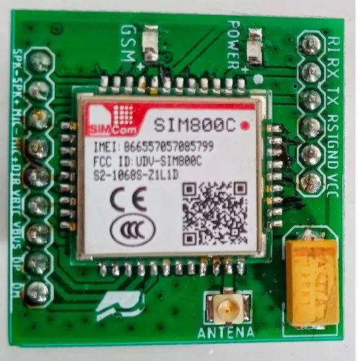
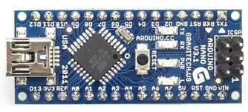
HARDWARE REQUIREMENTS
Arduino Nano
GSM Modem

Slide 9
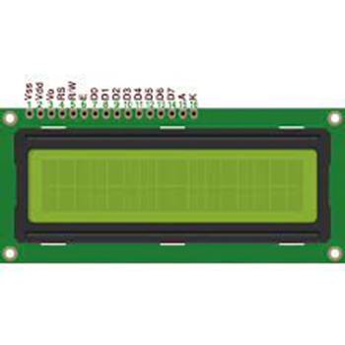
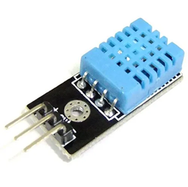
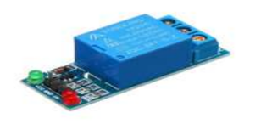
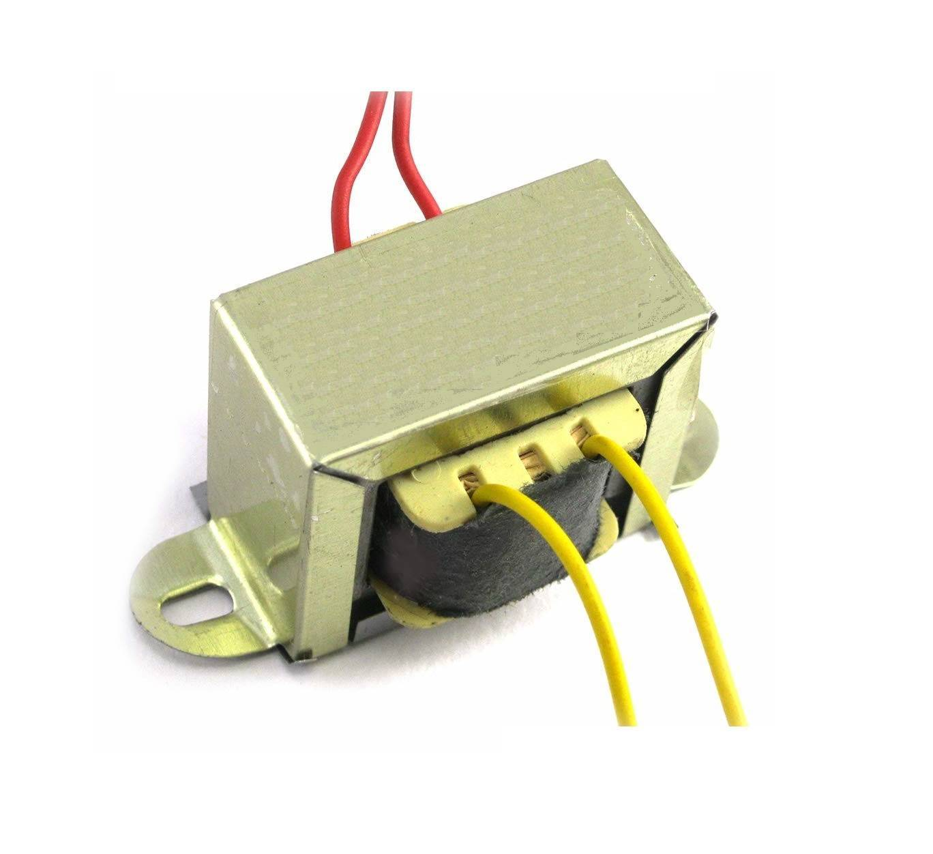


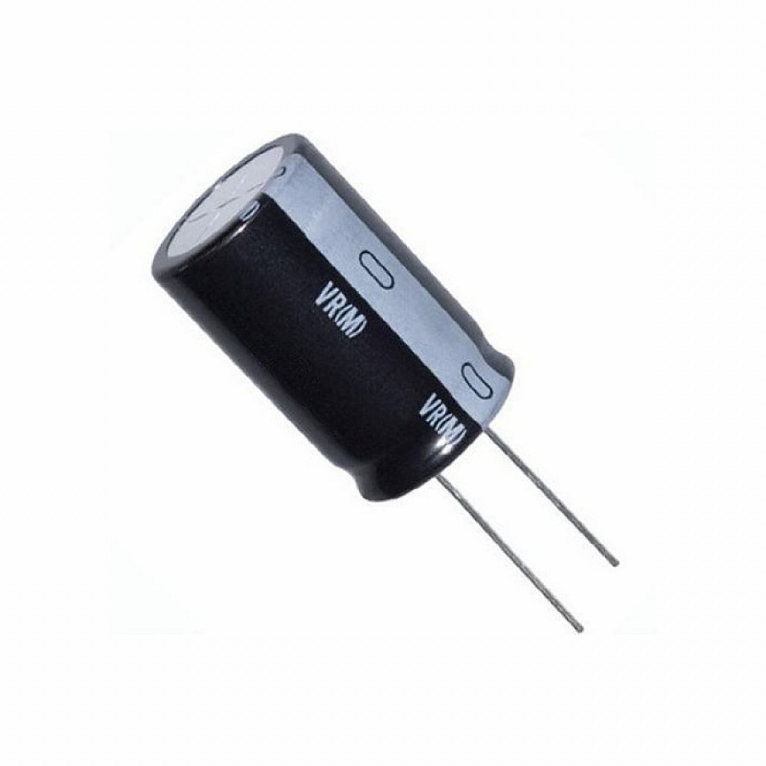

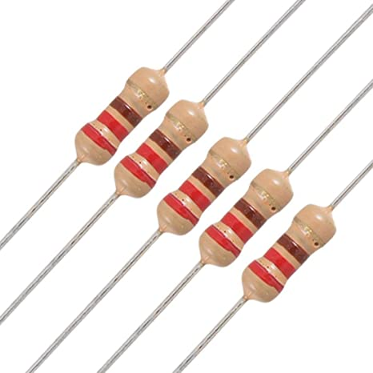
HARDWARE REQUIREMENTS
LCD Display
Relay
DHT11 Temperature Sensor
Transformer
Buzzer
Switch/Push button
Capacitor
Resistors
LED

Slide 10

SOFTWARE REQUIREMENTS

Slide 11
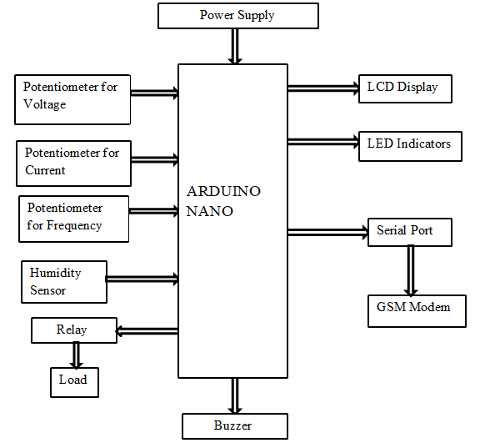
BLOCK DIAGRAM

Slide 12
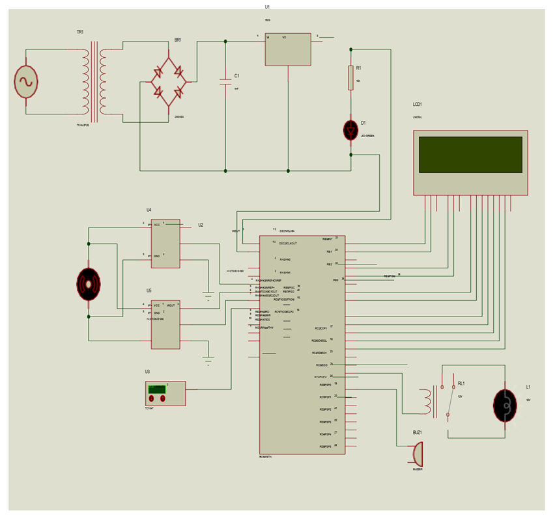
CIRCUIT DIAGRAM
Circuit Diagram of Regulated Power Supply

Slide 13
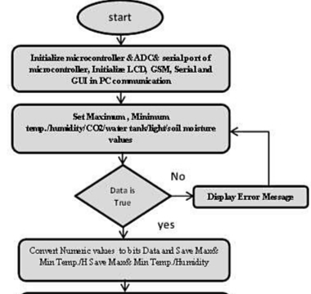
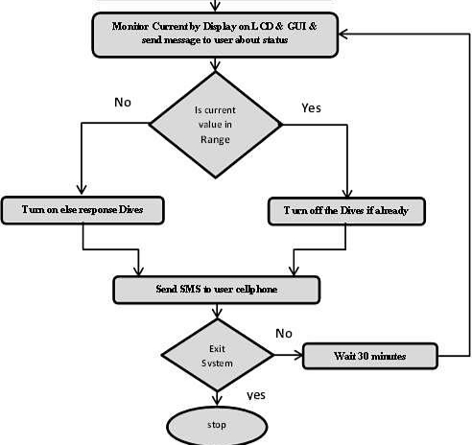
FLOWCHART

Slide 14
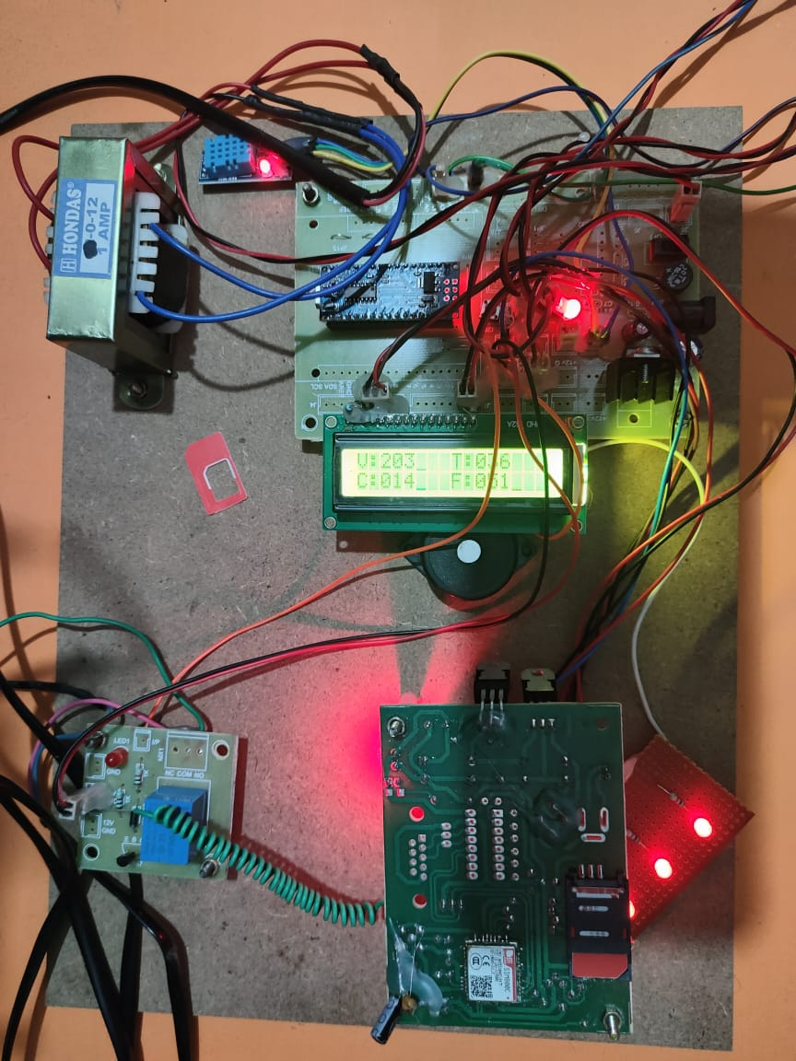
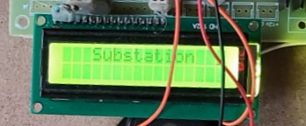
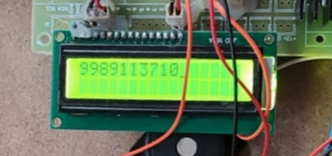
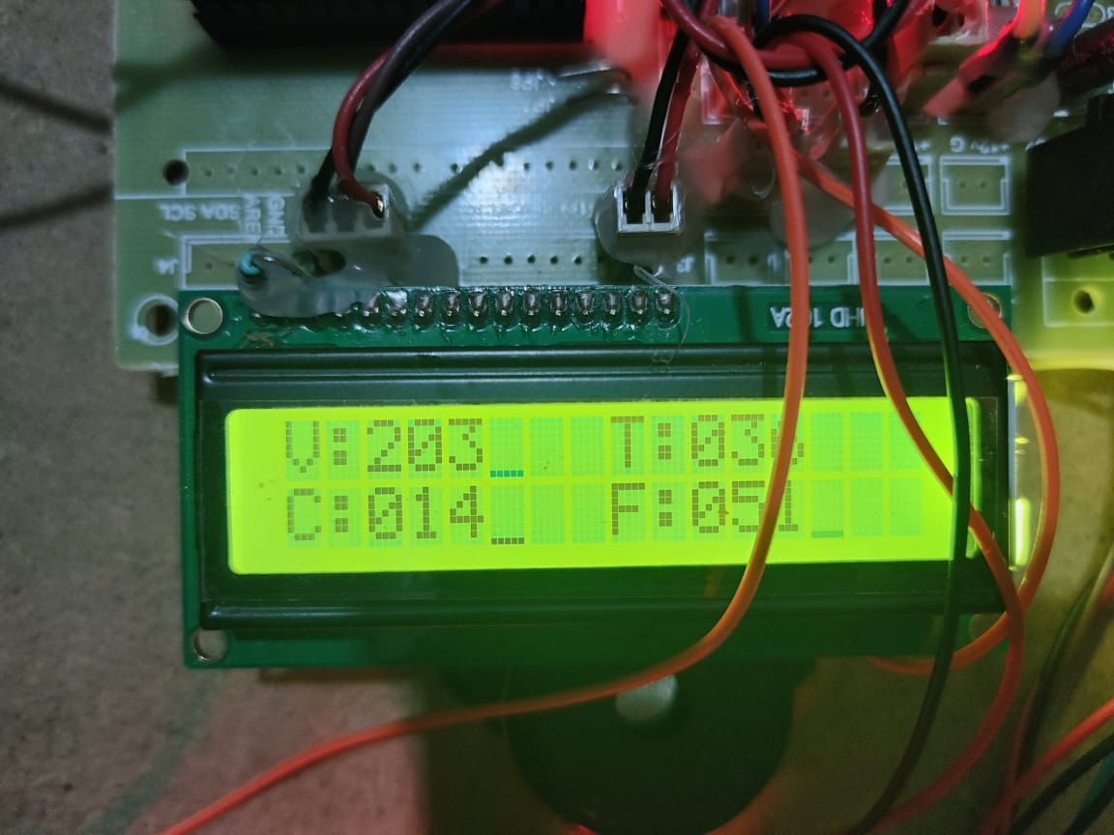
HARDWARE IMPLEMENTATION
Fig-2: switch on the kit
Fig-3: Registering the contact number
Fig-1: Hardware Implementation
Fig-4: Monitoring the electrical parameters

Slide 15
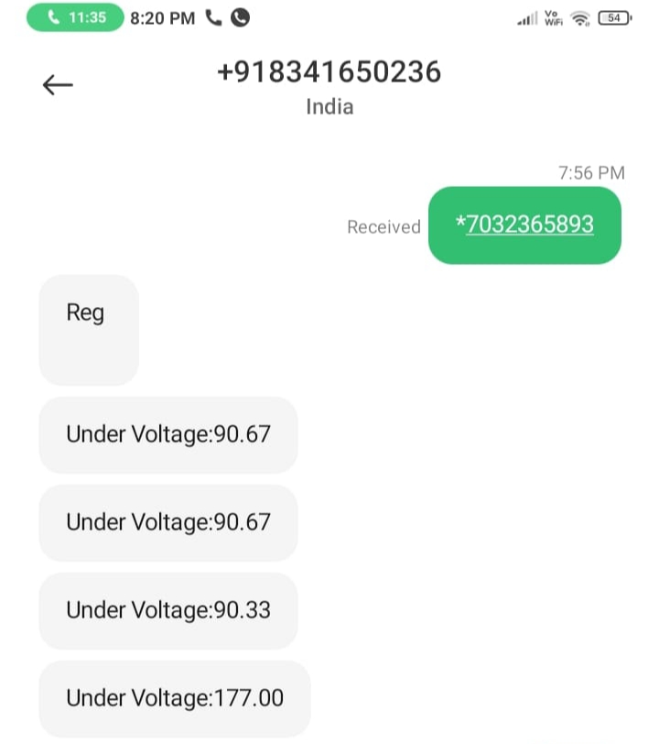
RESULTS
Fig-5: Monitoring results through SMS Commands

Slide 16
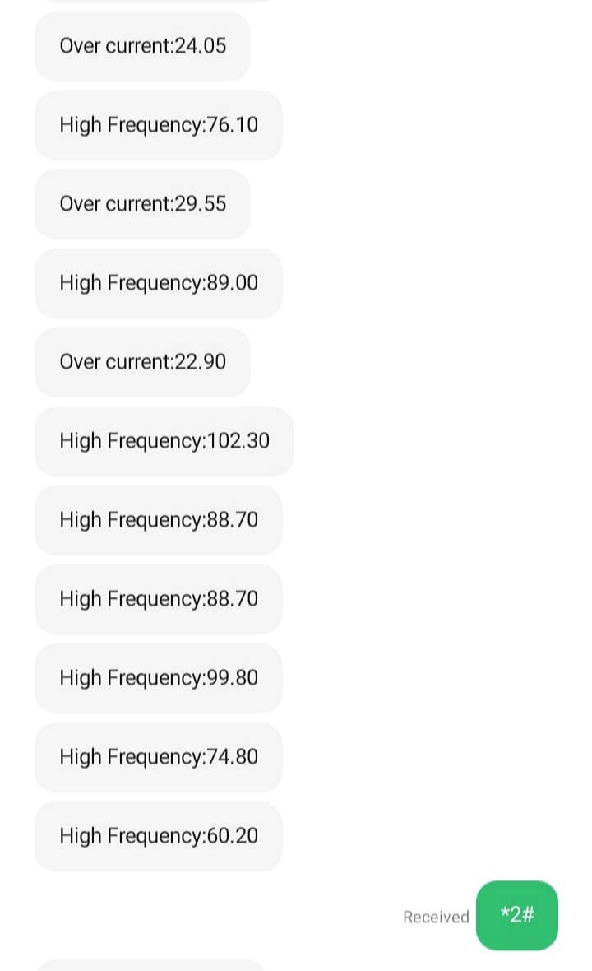
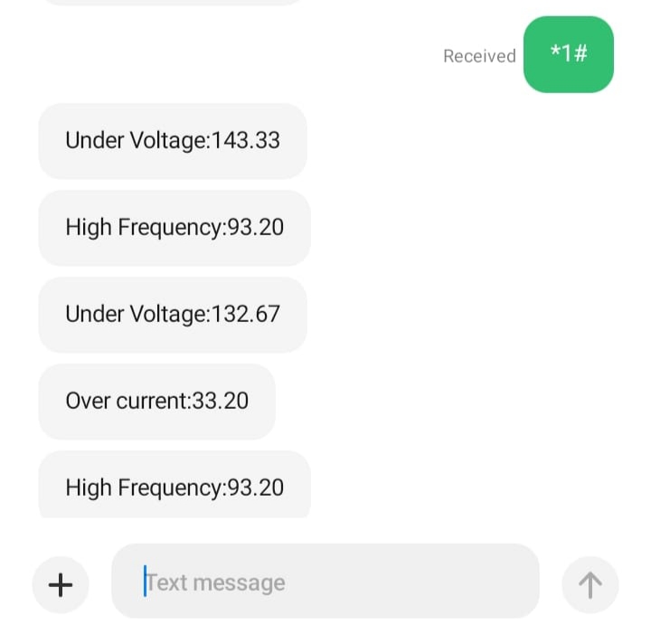
RESULTS
Fig-6: Controlling Using Load On
Fig-7: Controlling Using Load Off

Slide 17
ADVANTAGES & DISADVANTAGES
ADVANTAGES:
Efficient and low cost design
Low power consumption.
Real time monitoring.
GSM based user-friendly interfacing
Fast response and long life
GSM message alerts
Controls low and high voltage and current devices
Devices can be operated from anywhere in the world.
Feedback of the devices being operated is present.
The immediate attention can take place if a variation happens in the sub-station parameters.
DISADVANTAGES:
Depends on the network signal strength for communication
GSM interfacing is sensitive.

Slide 18
APPLICATIONS
APPLICATIONS:
This system can be used to monitoring and controlling the home appliances.
This system be used in places where humans cannot work.
Robots play vital role in detecting the explosives by using this application.
This system be used in military applications.
This system can be implemented in industries.

Slide 19
Conclusion
We can improve the quality of power transferred and provide uninterrupted power supply.
The real time monitoring of different parameters is done which can provide safety to the substation and its equipments.
Substation is monitored and controlled to avoid heavy blast caused due to overload. By using GSM, the critical condition is informed to authorized person as SMS to prevent substation from overload. In advancement, tapping of current can be analyzed.
Secondly, using highly advanced IC’s with the help of growing technology gives the effective results in the project

Slide 20
REFERENCES
[1]https://jespublication.com/upload/2020-110515.pdf
[2]https://www.researchgate.net/publication/341384599_Substation_control_and_monitoring_using_GSM
[3] Mrs. Krupal Dhimar, Mr. Jenish Patel, Mr. Yasin Shaikh, Mr. Anas Musani, Mr. Krishn Patel, “Substation Monitoring and Control Using Microcontroller & GSM” inInternational Research Journal of Engineering and Technology (IRJET), Volume: 04 Issue:04,Apr-2017
[4]https://www.slideshare.net/priyarachakonda/microcontroller-based-substation-monitoring-system-with-gsm-modem
[5] Amit Sachan,” Microcontroller Based Substation Monitoring and Control System with Gsm Modem” in IOSR Journal of Electrical and Electronics Engineering (IOSRJEEE), Volume 1, Issue 6 (July-Aug. 2012)

Slide 21
THANK YOU

